Slide 1


SMART INDIA HACKATHON 2025
TITLE PAGE
Problem Statement ID –25028
Problem Statement Title- Smart Classroom & Timetable Schedular
Theme- Smart Education
PS Category- Software
Team ID-
Team Name (Registered on portal)- BugOFF

Slide 2
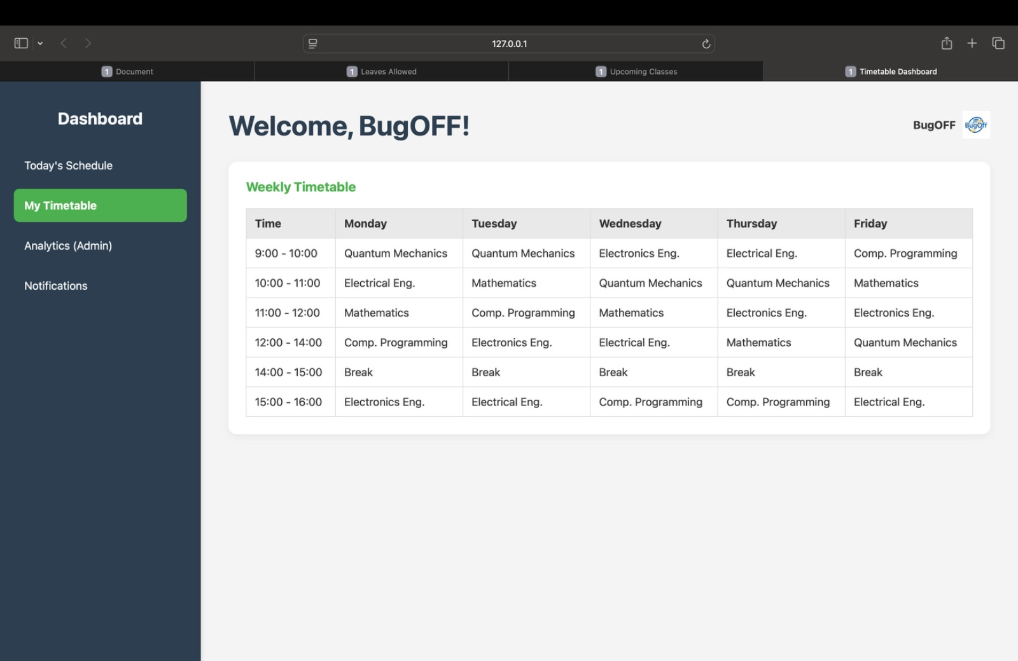
The Daily Compass
Navigating Day-to-day Schedule
Navigating Day-to-day Educational Schedules
Educational institutions face complex scheduling challenges that impact learning outcomes and resource utilization. Our smart scheduling solution transforms chaotic timetabling into streamlined, conflict-free schedules.
01
Identify Constraints
Faculty availability, room capacity, subject requirements
02
Optimize Resources
Balance workloads and maximize facility utilization
03
Generate Schedules
Create conflict-free, efficient timetables automatically
Team BugOFF - Delivering intelligent solutions for smarter education
@SIH Idea submission- Template

Slide 3






Technical Approach
Input Data
Programming Languages
Faculty, rooms, subjects, student groups
Constraint Engine
Apply scheduling rules and limitations
Schedule Optimization
Front End
Backend
AI-driven resource allocation
Conflict Resolution
Automatic error detection and fixing
Timetable Output
HTML
CSS
Python
SQL
Clean, conflict-free schedules
Core Algorithm
Manual Override
Scalability
Generates conflict-free timetables by intelligently allocating subjects, faculty, rooms, and time slots while continuously checking constraints.
Handles holidays and special events by removing affected slots from availability lists, ensuring flexibility.
OR-Tools constraint programming ensures the solution scales effectively for larger educational institutions.
Team BugOFF - Advanced algorithms meet educational excellence
@SIH Idea submission- Template

Slide 4


Feasibility and Viability
Market Analysis
Implementation Strategy
1
Pilot Testing
Start with small institutions to refine algorithms and user interface
2
Gradual Scaling
Expand to larger institutions with enhanced OR-Tools integration
3
Risk Mitigation
Backup manual override systems and comprehensive user training programs
Key Challenge: Adapting to diverse institutional scheduling preferences requires flexible algorithm parameters and extensive customization options.
The global education scheduling software market is experiencing rapid growth, with institutions increasingly adopting digital solutions for administrative efficiency.
78%
92%
Time Saved
Accuracy Rate
Reduction in manual scheduling effort
Conflict-free schedule generation
@SIH Idea submission- Template

Slide 5









Impact and Benefits
Administrative Efficiency
Resource Optimization
Eliminates hours of manual scheduling work, freeing staff for student-focused activities
Maximizes classroom and faculty utilization while minimizing conflicts
Cost Reduction
Enhanced Learning
Decreases administrative overhead and improves operational efficiency
Reduces schedule disruptions, creating more stable learning environments
Social Impact
Economic Benefits
Environmental Gains
Better work-life balance for educators
Lower administrative costs
Paperless scheduling process
Improved student attendance rates
Increased productivity
Optimized facility usage
Reduced scheduling conflicts
Better resource utilization
Reduced travel for meetings
@SIH Idea submission- Template

Slide 6





Research and References
Academic Foundation
Industry Analysis
Built upon extensive research in constraint satisfaction problems and educational scheduling optimization algorithms from leading computer science journals.
Market research from EdTechHub and global education technology reports highlighting the critical need for automated scheduling solutions.
Technical References
Google OR-Tools documentation and constraint programming methodologies for scalable optimization in educational environments.
Key Research Areas
Validation Methods
Constraint satisfaction algorithms
Case studies from pilot institutions
Educational scheduling optimization
Performance benchmarking
User experience in administrative software
User feedback analysis
Scalability in institutional systems
Comparative efficiency studies
"Automated scheduling systems can reduce administrative workload by up to 80% while improving resource utilization and schedule quality." - Educational Technology Research Journal
@SIH Idea submission- Template

